Slide 1
SURVIVAL PLOTS FOR SURVEY
VR

Slide 2
BACKGROUND
Time-to-event analysis “survival analysis” is a key area of statistics that has several applications in clinical practice, for instance, in the management of Noncommunicable diseases, to understand survival time, time to recurrence, or relapse.
This survey aims to understand clinicians’ preferences in visualizing survival data.
There will be 3 types of survival plots: Kaplan Meier, survival ratio, and survival difference plots. The same data is displayed differently. We would like to know your preference among the 3 plots. Interpretations will be provided.
This study is conducted by Victor and Shyam in fulfillment of MSc in health data science at the University of Galway.
All the responses are anonymous and Participation is voluntary. It will take 5 min
Your input is highly valued, and we appreciate your time in completing this survey.
For more information: v.rwandarwacu1@universityofgalway

Slide 3
DATASET DESCRIPTION
The TCGA BRCA (The Cancer Genome Atlas Breast Invasive Carcinoma) is a publicly available resource,
The clinical dataset provides comprehensive patient-level clinical information to support breast cancer research. It includes key variables such as demographics, tumor characteristics (pathologic TNM staging, histologic type, hormone receptor status), treatment details, survival outcomes, and recurrence status.
This dataset enables the analysis of prognostic factors, survival patterns, and treatment responses, making it a valuable resource for understanding clinical outcomes in breast cancer.
This data set will be used to visualize survival among patients with different pathologic stages.

Slide 4
Comparison of survival between Pathologic stage II and III of Breast Cancer

Slide 5
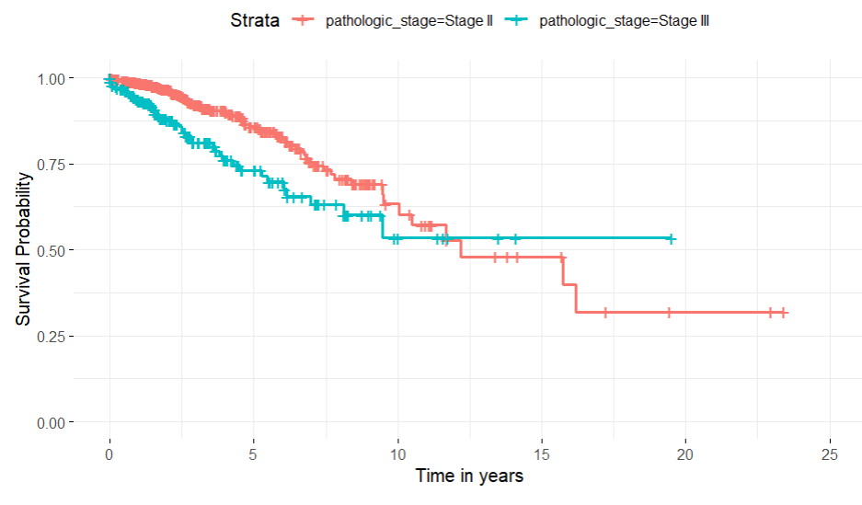
KM Plot :Pathologic stage II and III
Notes:
"This plot shows how long patients with different stages of a disease live. The red line is for patients with an early stage (Stage II), and the blue line is for patients with a later stage (Stage III). The higher the line, the more patients are still alive. The red line is higher, meaning patients with Stage II live longer than those with Stage III."

Slide 6
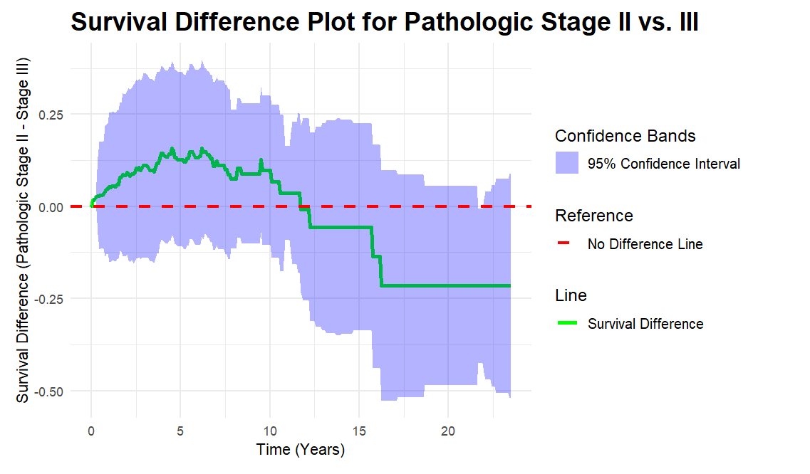
Survival difference plot: Pathologic stage II vs III
Notes:
"This plot shows the difference in survival rates between patients with early-stage (Stage II) and mid-stage (Stage III) disease over time. The green line shows that patients with Stage II tend to live longer than those with Stage III. The red dashed line means no difference. The purple shaded area shows how confident we are about this difference."

Slide 7
Comparison of survival between pathologic stage II and IV of Breast Cancer

Slide 8
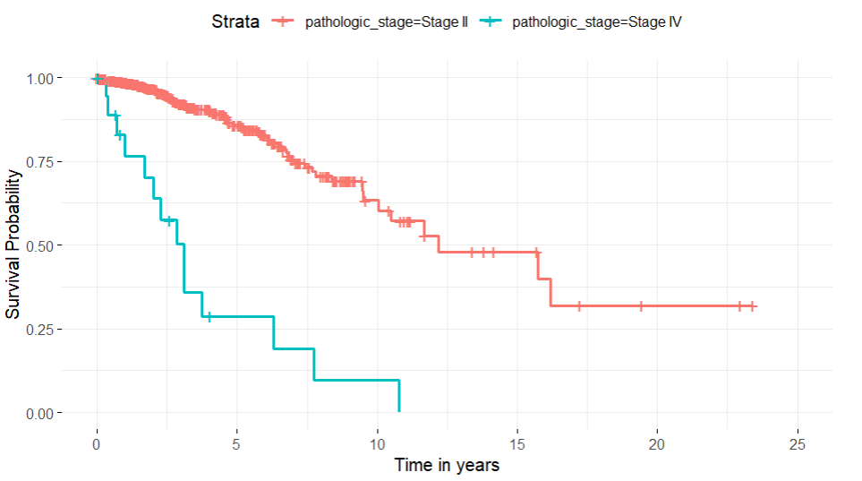
Comparison of survival between Pathologic stage II and IV
"This plot shows how long patients with different stages of a disease live. The red line is for patients with an early stage (Stage II), and the blue line is for patients with an advanced stage (Stage IV). The higher the line, the more patients are still alive. The red line is higher, meaning patients with Stage II live longer than those with Stage IV."

Slide 9
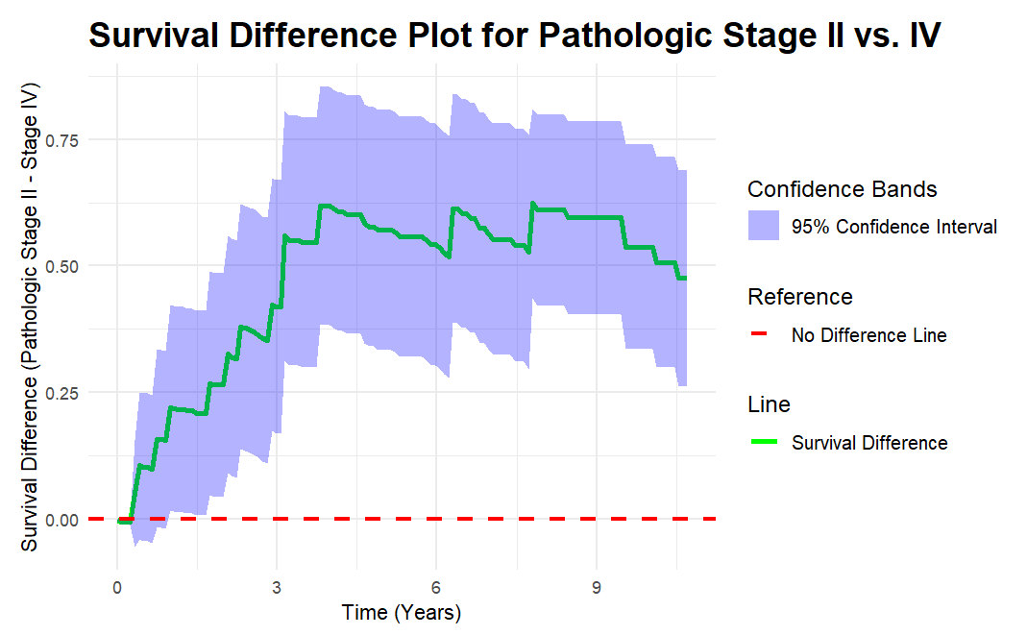
"This plot shows the difference in survival rates between patients with early-stage (Stage II) and late-stage (Stage IV) disease over time. The green line shows that as time goes on, patients with Stage II tend to live longer than those with Stage IV. The red dashed line means no difference. The blue shaded area shows how confident we are about this difference."

Slide 10
Comparison of survival between patients with lymph node metastasis N0 /N2

Slide 11
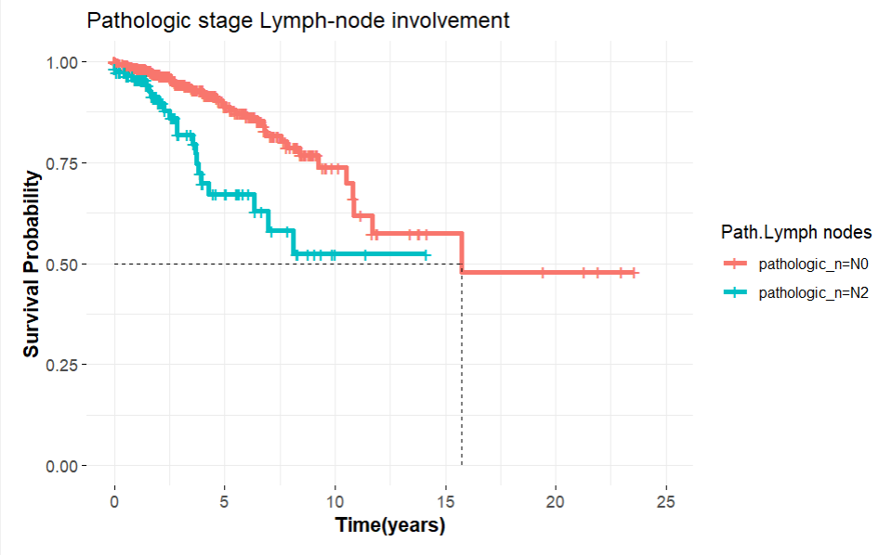
TNM(N0/N2)
Notes:
"This plot shows how long patients with different levels of lymph-node involvement live. The red line is for patients with no lymph-node involvement (N0), and the blue line is for patients with more lymph-node involvement (N2). The higher the line, the more patients are still alive. The red line is higher, meaning patients with no lymph-node involvement live longer than those with more lymph-node involvement."

Slide 12
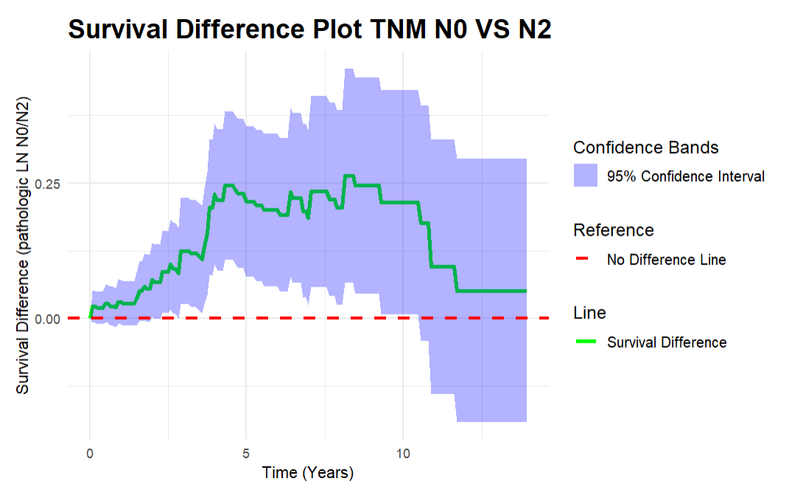
TNM (N0/N2)
Notes:
"This plot shows the difference in survival rates between patients with no lymph-node involvement (N0) and those with more lymph-node involvement (N2) over time. The green line shows that patients with no lymph-node involvement tend to live longer than those with more lymph-node involvement. The red dashed line means no difference. The purple shaded area shows how confident we are about this difference."

